Slide 1
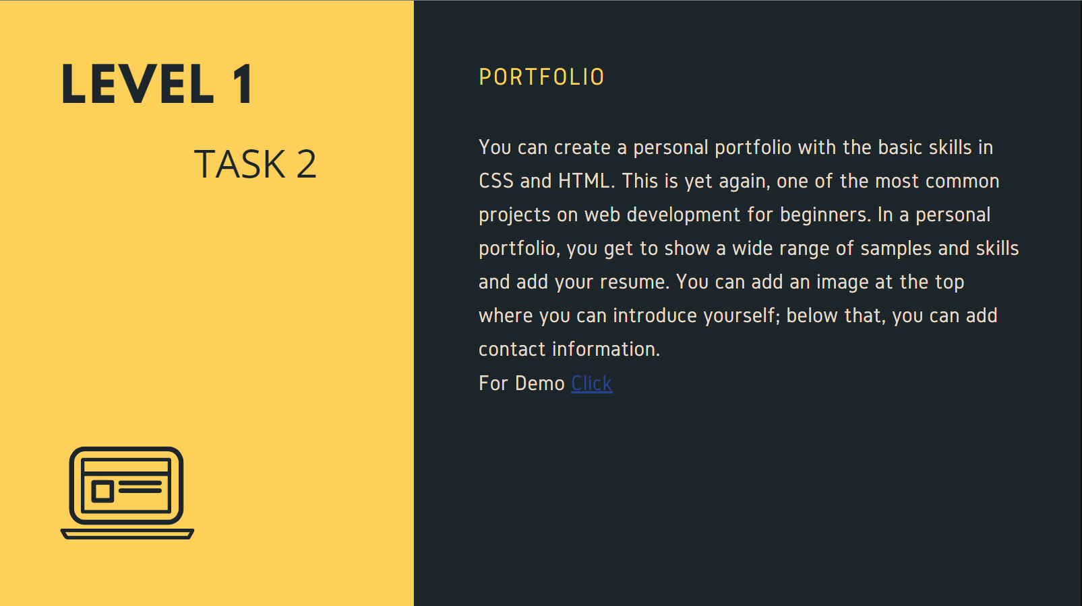
Oasis Infobyte
Level 1 > Task 2
PORTFOLIO (using HTML and CSS)
-- ABHISHEK TIJARE

